Slide 1

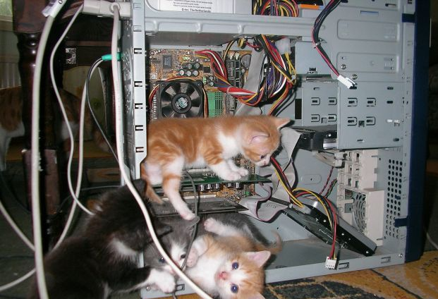
Introduction to Computer Science
Shimon Schocken
IDC Herzliya
Lecture 7-2
Computer Fundamentals
Part I
Notes:
1

Slide 2


Overview
Goals
Explore how computers work
Explore low-level programming
Explore the road from the low-level to the high level
computer
Approach
Introduce a simple hardware platform
Write some machine language programs
Understand the hardware – software interplay, hands-on.

Slide 3
Lecture plan
Hardware platform (Vic)
Architecture
Instructions
Low-level programming
Basic
Branching
Fetch-execute cycle
Program translation
From Vic to a real computer

Slide 4
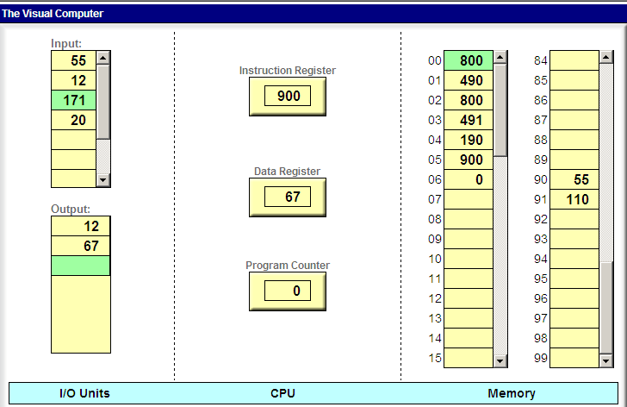
Vic: a simple computer architecture (www1.idc.ac.il/vic)
0
1

Slide 5
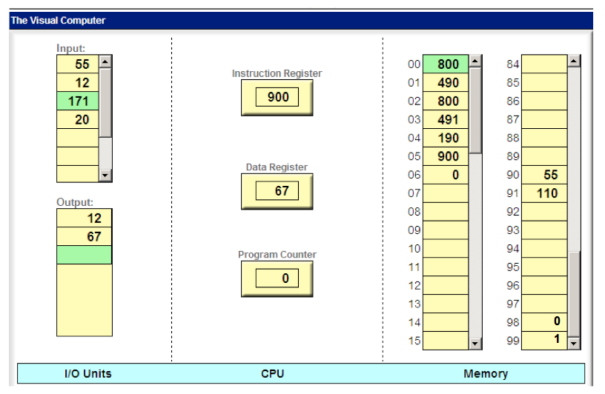
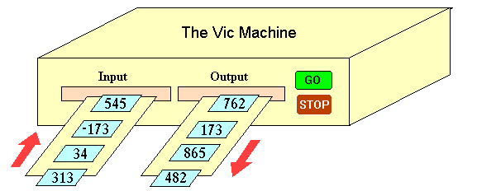
Vic: a simple computer architecture (www1.idc.ac.il/vic)
inside view:
outside view:
instructions:
Hmmm … How
can I make this thing do some useful things?
read
write
load
store
add
sub
...

Slide 6
Data bus
read from input
load from memory
write to output
store to memory
0
1

Slide 7
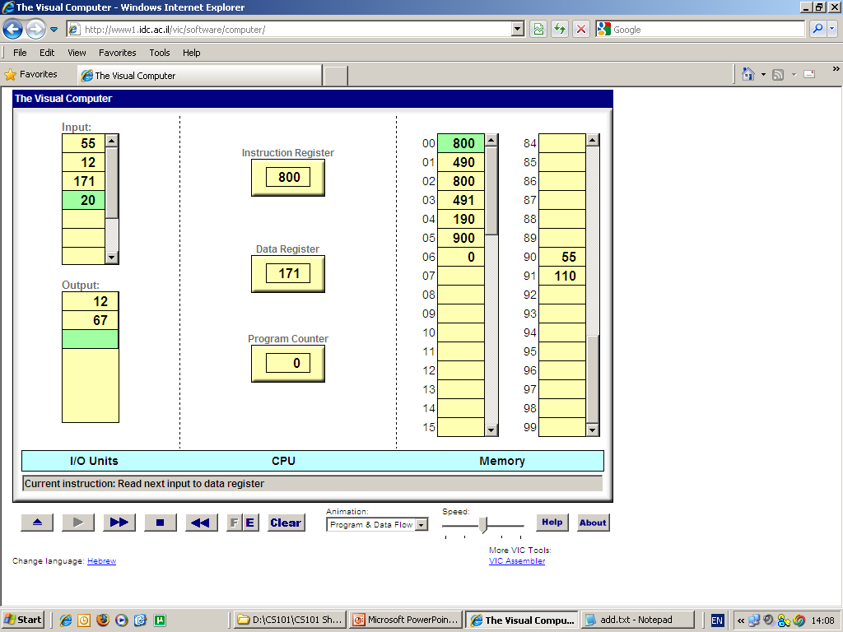
Instruction set
symbolic numeric semantics
syntax syntax (meaning)
read 800 D = input
write 900 output = D
load xx 3xx D = M[xx]
store xx 4xx M[xx] = D
add xx 1xx D = D + M[xx]
sub xx 2xx D = D - M[xx]

Slide 8
Read operation
symbolic numeric semantics
syntax syntax (meaning)
read 800 D = input
write 900 output = D
load xx 3xx D = M[xx]
store xx 4xx M[xx] = D
read
add xx 1xx D = D + M[xx]
sub xx 2xx D = D - M[xx]
following execution:

Slide 9
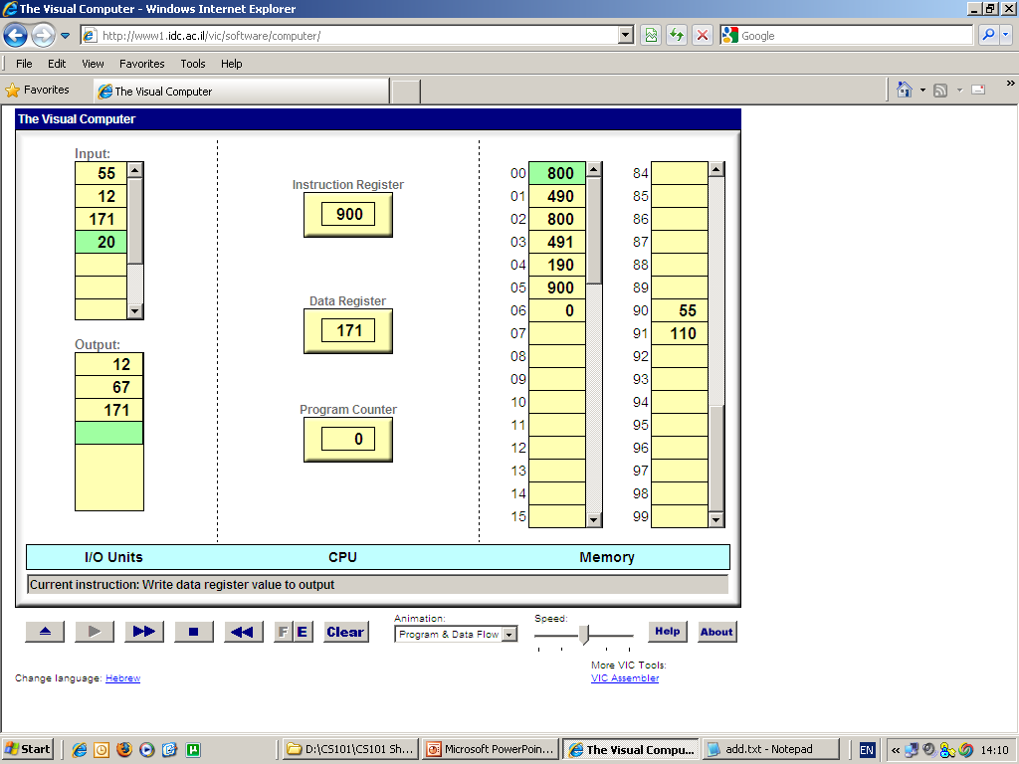
Write operation
symbolic numeric semantics
syntax syntax (meaning)
read 800 D = input
write 900 output = D
load xx 3xx D = M[xx]
store xx 4xx M[xx] = D
write
add xx 1xx D = D + M[xx]
sub xx 2xx D = D - M[xx]
following execution:

Slide 10
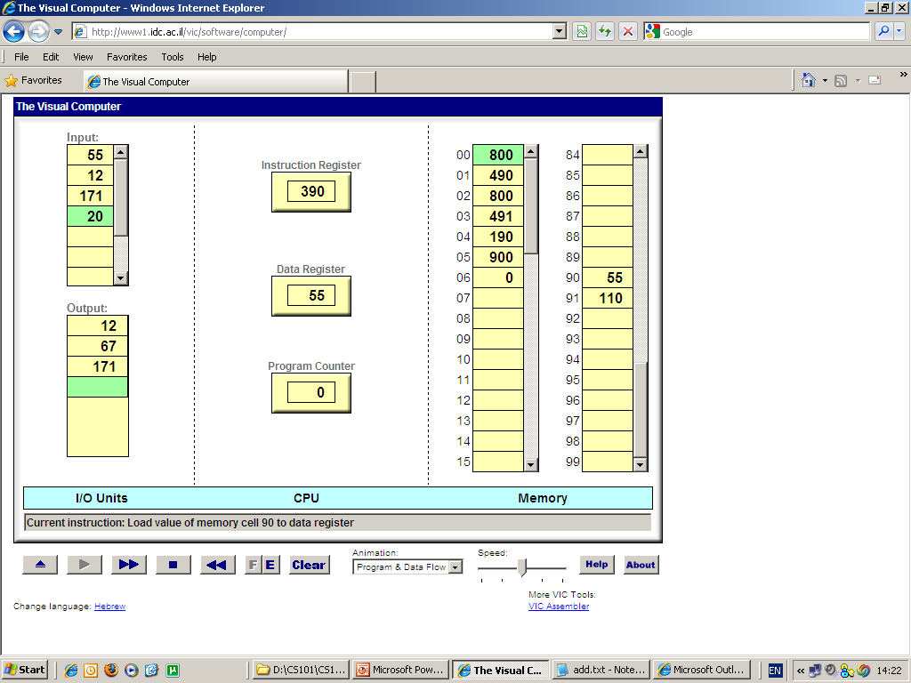
Load operation
symbolic numeric semantics
syntax syntax (meaning)
read 800 D = input
write 900 output = D
load xx 3xx D = M[xx]
store xx 4xx M[xx] = D
load 90
add xx 1xx D = D + M[xx]
sub xx 2xx D = D - M[xx]
following execution:

Slide 11
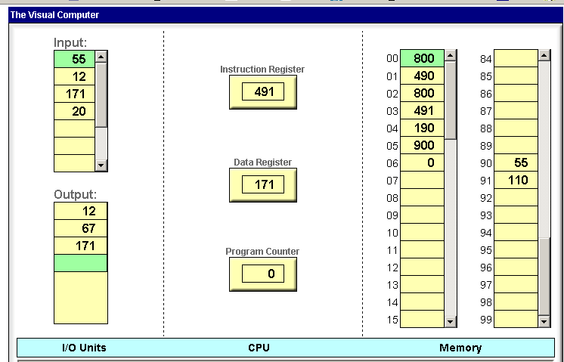

Store operation
symbolic numeric semantics
syntax syntax (meaning)
read 800 D = input
write 900 output = D
load xx 3xx D = M[xx]
store xx 4xx M[xx] = D
store 91
add xx 1xx D = D + M[xx]
sub xx 2xx D = D - M[xx]
following execution:

Slide 12
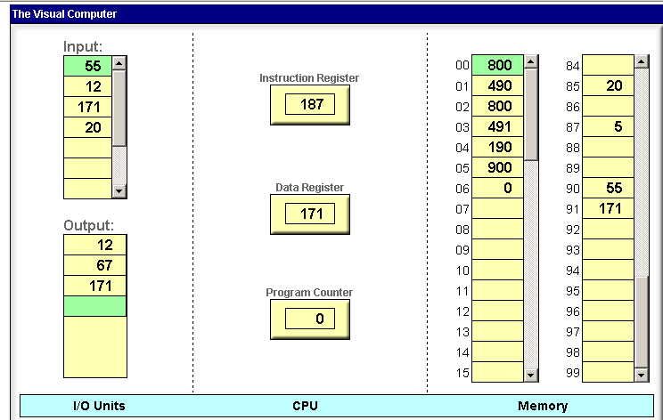

Add operation
symbolic numeric semantics
syntax syntax (meaning)
read 800 D = input
write 900 output = D
load xx 3xx D = M[xx]
store xx 4xx M[xx] = D
add 87
add xx 1xx D = D + M[xx]
sub xx 2xx D = D - M[xx]
following execution:

Slide 13

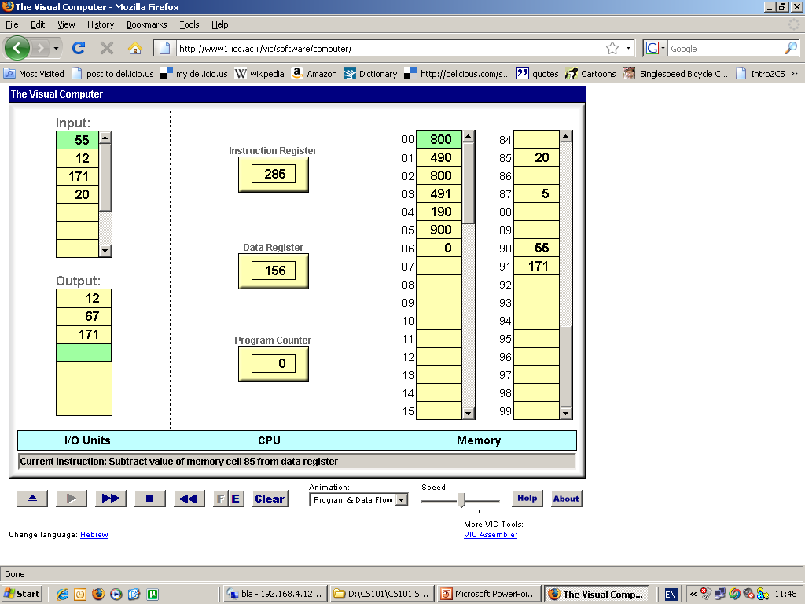
Subtract operation
symbolic numeric semantics
syntax syntax (meaning)
read 800 D = input
write 900 output = D
load xx 3xx D = M[xx]
store xx 4xx M[xx] = D
sub 85
add xx 1xx D = D + M[xx]
sub xx 2xx D = D - M[xx]
following execution:

Slide 14
Lecture plan
Hardware platform (Vic)
Architecture
Instructions
Low-level programming
Basic
Branching
Fetch-execute cycle
Program translation
From Vic to a real computer

Slide 15


Low-level programming
Task: read two numbers and write their sum.
Logic / algorithm
x = read a number
y = read a number
print(x + y)
High-level thinking…
High-level programming:
Think about the code abstractly, using a formalism like Java / Python,
Without worrying about how the machine handles this logic.

Slide 16
Low-level programming
Task: read two numbers and write their sum.
Logic / algorithm
symbolic program
executable code
read a number
store it somewhere // a
read a number
store it somewhere // b
add a // to D
write
stop
00
01
02
03
04
05
06
read
store 90
read
store 91
add 90
write
stop
00
01
02
03
04
05
06
800
490
800
491
190
900
000
Low-level thinking…
implement
translate
symbolic numeric semantics
syntax syntax (meaning)
read 800 D = input
write 900 output = D
Low-level programming:
Thinking about the code mechanically, in terms of machine-level operations.
load xx 3xx D = M[xx]
store xx 4xx M[xx] = D
add xx 1xx D = D + M[xx]
sub xx 2xx D = D - M[xx]

Slide 17
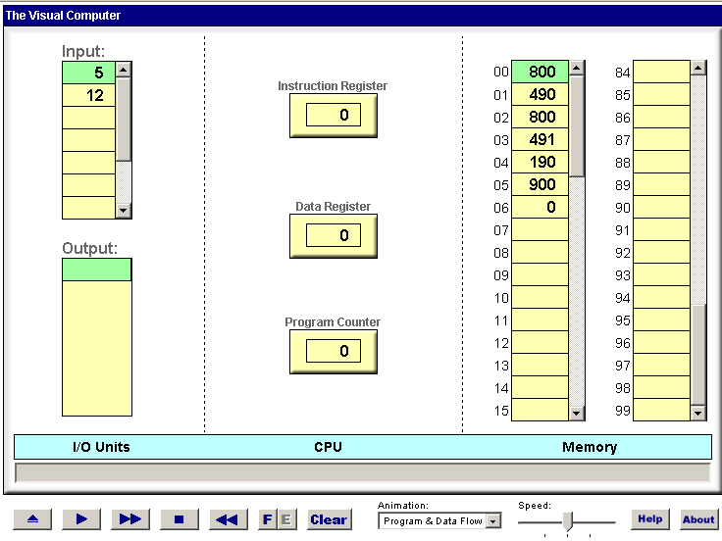

Loading and executing a program
Loaded ”read and add two numbers" code
after the program terminates:
execute

Slide 18
Loading and executing a program
Fetch-execute cycle:
(basic version)
IR:
PC = 0
fetch:
IR = M[PC]
if (IR == 0) goto end
execute IR (read, write, load, …)
PC++
goto fetch
end:
do nothing
D:
PC:
How is the fetch-execute logic implemented?
It is hard-wired into the computer hardware (not shown in this lecture).
When I load a program into the computer and say “execute”, the program gets executed
How does this magic happen?

Slide 19
Lecture plan
Hardware platform (Vic)
Architecture
Instructions
Low-level programming
Basic
Branching
Fetch-execute cycle
Program translation
From Vic to a real computer

Slide 20
Branching
Default flow of control: linear
Typical flow of control: branching
command
command
command
command
command
command
command
command
command
command
command
command
command
command
command
label a
command
if condition goto b
command
command
label b
command
command
if condition goto c
command
label c
command
goto a

Slide 21
Branching
Low-level branching instruction: goto addr
addr: An address, marks a location in the code
goto: Used to transfer the flow of control to a selected location in the code
Vic features three branching instructions:
Symbolic Exec. Semantics
goto xx 5xx goto xx
gotoz xx 6xx if (D == 0) goto xx
gotop xx 7xx if (D > 0) goto xx
Task (example): Read and write until 0 is read
00
01
02
03
04
read
gotoz 04
write
goto 00
stop

Slide 22
Branching
Task: Read two numbers and write the greater one
machine language
00
01
02
03
04
05
06
07
08
09
10
11
...
Branching instructions:
Symbolic Exec. Semantics
goto xx 5xx goto xx
gotoz xx 6xx if (D == 0) goto xx
gotop xx 7xx if (D > 0) goto xx

Slide 23
Branching
Task: Read two numbers and write the greater one
machine language
read
store x
read
store y
sub x
gotop YISMAX
load x
write
stop
load y
write
stop
00
01
02
03
04
05
06
07
08
09
10
11
...
Branching instructions:
Symbolic Exec. Semantics
goto xx 5xx goto xx
gotoz xx 6xx if (D == 0) goto xx
gotop xx 7xx if (D > 0) goto xx

Slide 24
Branching
Task: Read two numbers and write the greater one
machine language
read
store x
read
store y
sub x
gotop YISMAX
load x
write
stop
load y
write
stop
00
01
02
03
04
05
06
07
08
09
10
11
...
Branching instructions:
Symbolic Exec. Semantics
goto xx 5xx goto xx
gotoz xx 6xx if (D == 0) goto xx
gotop xx 7xx if (D > 0) goto xx

Slide 25
Branching
Task: Read two numbers and write the greater one
machine language
read
store x
read
store y
sub x
gotop 09
load x
write
stop
load y
write
stop
00
01
02
03
04
05
06
07
08
09
10
11
...
Branching instructions:
Symbolic Exec. Semantics
goto xx 5xx goto xx
gotoz xx 6xx if (D == 0) goto xx
gotop xx 7xx if (D > 0) goto xx

Slide 26
Branching
Task: Read two numbers and write the greater one
machine language
executable code
read
store x
read
store y
sub x
gotop 09
load x
write
stop
load y
write
stop
Convention: Allocate variables to memory, from address 90 onward:
x: represented by M[90]
y: represented by M[91]
800
490
800
491
290
709
390
900
000
391
900
000
00
01
02
03
04
05
06
07
08
09
10
11
...
00
01
02
03
04
05
06
07
08
09
10
11
...
translate
load
Branching instructions:
Symbolic Exec. Semantics
goto xx 5xx goto xx
gotoz xx 6xx if (D == 0) goto xx
gotop xx 7xx if (D > 0) goto xx

Slide 27
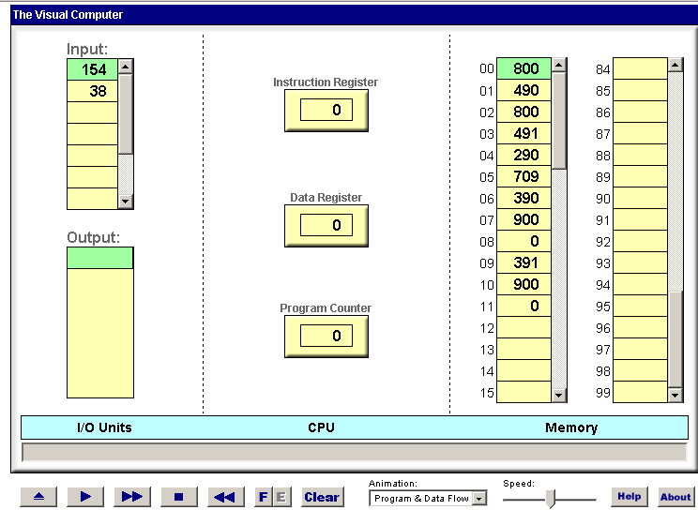
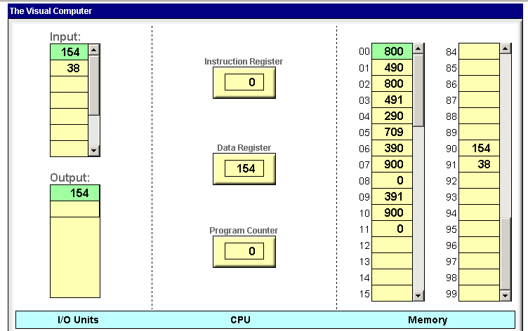
Branching
“max of two numbers” program
After the program terminates:

Slide 28
Lecture plan
Hardware platform (Vic)
Architecture
Instructions
Low-level programming
Basic
Branching
Fetch-execute cycle
Program translation
From Vic to a real computer

Slide 29
Fetch–execute cycle
PC = 0
fetch:
IR == M[PC]
if (IR == 0) goto end
if ( (IR == 5xx) or
(IR == 6xx and D == 0) or
(IR == 7xx and D > 0) )
PC = xx
else
execute IR (read, write, load, store, add, sub)
PC++
goto fetch
end:
goto end
IR:
D:
PC:
Symbolic Exec. Semantics
goto xx 5xx goto xx
gotoz xx 6xx if (D == 0) goto xx
gotop xx 7xx if (D > 0) goto xx

Slide 30
Fetch–execute cycle
PC = 0
fetch:
IR == M[PC]
if (IR == 0) goto end
if ( (IR == 5xx) or
(IR == 6xx and D == 0) or
(IR == 7xx and D > 0) )
PC = xx
else
execute IR (read, write, load, store, add, sub)
PC++
goto fetch
end:
goto end
IR:
D:
PC:
That’s it! the description of the Vic computer is now complete.

Slide 31
The Vic computer specification (recap)
symbolic numeric semantics
syntax syntax (meaning)
read 800 D = input
write 900 output = D
Conventions:
each command is represented as a 3-digit number
D: data register
xx: a two digit number
M[xx]: contents of the RAM at address xx
I/O
Instructions
memory Instructions
load xx 3xx D = M[xx]
store xx 4xx M[xx] = D
arithmetic Instructions
add xx 1xx D = D + M[xx]
sub xx 2xx D = D - M[xx]
control Instructions
goto xx 5xx goto xx
gotoz xx 6xx if (D == 0) goto xx
gotop xx 7xx if (D > 0) goto xx
I/O
CPU
RAM

Slide 32
Lecture plan
Hardware platform (Vic)
Architecture
Instructions
Low-level programming
Basic
Branching
Fetch-execute cycle
Program translation
From Vic to a real computer

Slide 33
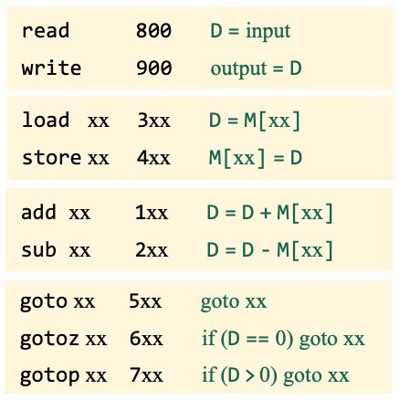
Symbolic programming
Symbolic Exec. Semantics
Task: sum up a series of numbers that ends with a zero
Pseudo code (goto-oriented)
Symbolic program
sum = 0
LOOP:
read x
if (x == 0) goto END
sum = sum + x
goto LOOP
END:
write sum
stop
write
Express the pseudo code using machine instructions
Instruction set

Slide 34
Symbolic programming
Symbolic Exec. Semantics
Task: sum up a series of numbers that ends with a zero
Pseudo code (goto-oriented)
Symbolic program
sum = 0
LOOP:
read x
if (x == 0) goto END
sum = sum + x
goto LOOP
END:
write sum
stop
write
// sum = 0
load zero
store sum
LOOP:
// read x
read
store x
// if (x == 0) goto END
gotoz END
// sum = sum + x
load sum
add x
store sum
goto LOOP
END:
// write sum
load sum
write
stop
Express the pseudo code using machine instructions
Instruction set
Let’s remove the white space, and add line numbers

Slide 35
Symbolic programming
Task: sum up a series of numbers that ends with a zero
Pseudo code (goto-oriented)
Symbolic program
sum = 0
LOOP:
read x
if (x == 0) goto END
sum = sum + x
goto LOOP
END:
write sum
stop
write
00
01
02
03
04
05
06
07
08
09
10
11
load zero
store sum
LOOP:
read
store x
gotoz END
load sum
add x
store sum
goto LOOP
END:
load sum
write
stop
Instruction set

Slide 36
Program translation
Task: sum up a series of numbers that ends with a zero
Pseudo code (goto-oriented)
Symbolic program
sum = 0
LOOP:
read x
if (x == 0) goto END
sum = sum + x
goto LOOP
END:
write sum
stop
write
00
01
02
03
04
05
06
07
08
09
10
11
load zero
store sum
LOOP:
read
store x
gotoz END
load sum
add x
store sum
goto LOOP
END:
load sum
write
stop
Symbol table:
zero: 98
one: 99
sum: 90
x: 91
LOOP: 2
END: 9
Instruction set
Symbol table:
Maps every symbol in the program to a memory address

Slide 37
Program translation
Task: sum up a series of numbers that ends with a zero
Pseudo code (goto-oriented)
Symbolic program
Executable code
sum = 0
LOOP:
read x
if (x == 0) goto END
sum = sum + x
goto LOOP
END:
write sum
stop
write
00
01
02
03
04
05
06
07
08
09
10
11
load zero
store sum
LOOP:
read
store x
gotoz END
load sum
add x
store sum
goto LOOP
END:
load sum
write
stop
translate
00
01
02
03
04
05
06
07
08
09
10
11
398
490
800
491
609
390
191
490
502
390
900
000
Symbol table:
zero: 98
one: 99
sum: 90
x: 91
LOOP: 2
END: 9
Instruction set
Symbol table:
Maps every symbol in the program to a memory address

Slide 38
Program translation
Task: sum up a series of numbers that ends with a zero
Pseudo code (goto-oriented)
Symbolic program
Executable code
sum = 0
LOOP:
read x
if (x == 0) goto END
sum = sum + x
goto LOOP
END:
write sum
stop
write
00
01
02
03
04
05
06
07
08
09
10
11
load zero
store sum
LOOP:
read
store x
gotoz END
load sum
add x
store sum
goto LOOP
END:
load sum
write
stop
translate
00
01
02
03
04
05
06
07
08
09
10
11
398
490
800
491
609
390
191
490
502
390
900
000
Symbol table:
zero: 98
one: 99
sum: 90
x: 91
LOOP: 2
END: 9
Observations
Compared to executable code, symbolic code is much easier to write / debug / maintain.
The symbolic code mentions no physical addresses. Therefore, it is relocatable.
The translation process can be automated.

Slide 39
Program translation
Task: sum up a series of numbers that ends with a zero
Pseudo code (goto-oriented)
Symbolic program
Executable code
sum = 0
LOOP:
read x
if (x == 0) goto END
sum = sum + x
goto LOOP
END:
write sum
stop
write
00
01
02
03
04
05
06
07
08
09
10
11
load zero
store sum
LOOP:
read
store x
gotoz END
load sum
add x
store sum
goto LOOP
END:
load sum
write
stop
translate
00
01
02
03
04
05
06
07
08
09
10
11
398
490
800
491
609
390
191
490
502
390
900
000
Symbol table:
zero: 98
one: 99
sum: 90
x: 91
LOOP: 2
END: 9
Terminology
Symbolic low-level code is called “assembly code”
The translator program is called “assembler”

Slide 40

Program translation: Vic
Task: sum up a series of numbers that ends with a zero
Pseudo code (goto-oriented)
Sum.asm
Sum.vic
sum = 0
LOOP:
read x
if (x == 0) goto END
sum = sum + x
goto LOOP
END:
write sum
stop
write
load zero
store sum
LOOP:
read
store x
gotoz END
load sum
add x
store sum
goto LOOP
END:
load sum
write
stop
translate
398
490
800
491
609
390
191
490
502
390
900
000
Using a text editor,
Using the Vic Assembler,
you write a Vic assembly program
you translate the assembly code into executable code

Slide 41
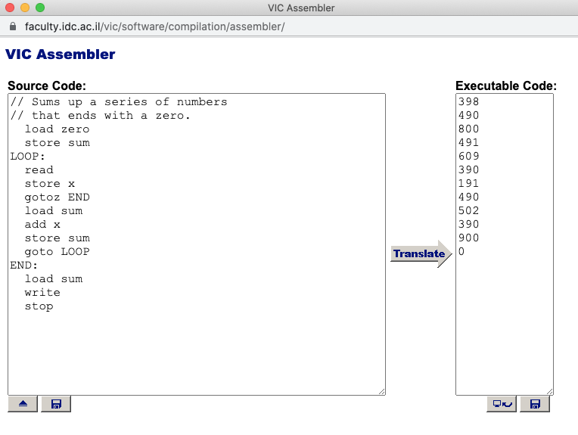
The Vic assembler
Task: sum up a series of numbers that ends with a zero
2
Loads an .asm file
1
3
Loads the resulting .vic file into the Vic computer

Slide 42
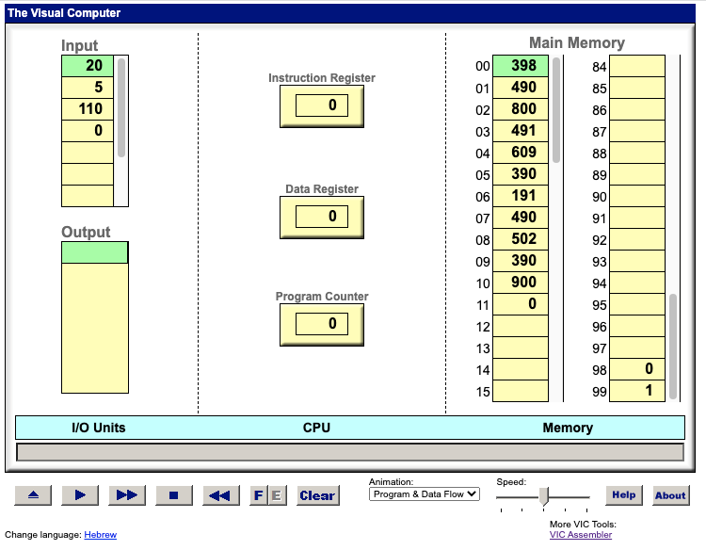
Executing the translated code
Task: sum up a series of numbers that ends with a zero
Loaded code
Enter some test data

Slide 43
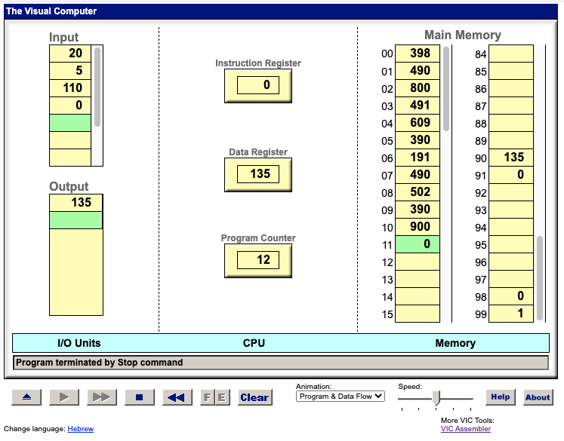
Executing the translated code
Task: sum up a series of numbers that ends with a zero
Loaded code
Enter some test data
result

Slide 44
Lecture plan
Hardware platform (Vic)
Architecture
Instructions
Low-level programming
Basic
Branching
Fetch-execute cycle
Program translation
From Vic to a real computer

Slide 45
From Vic to the real thing
Suppose we have unlimited supplies of money, time, and creativity;
How can we evolve Vic into a real computer?

Slide 46
From Vic to a real computer system: Hardware
Vic: Typical PC:
1 data register ……………… 32 data registers
3-digit words ....................... 64-bit words
100 memory cells ………….. billions of memory cells
1 memory unit ……………… RAM, ROM, cache
No secondary storage ………. disk
1 input port ………………… keyboard, mouse, disk, modem, …
1 output port………………… screen, speakers, disk, network, …
1 “computer”……………….. CPU + various I/O processors, one for each I/O device
10 Instructions ……………... 100-300 Instructions
1 program …………………. several programs running “simultaneously”
1 instruction per cycle …….. parallel processing.
I/O
CPU
RAM
Implementing any one of these improvements is a straightforward extension of the basic Vic architecture.

Slide 47


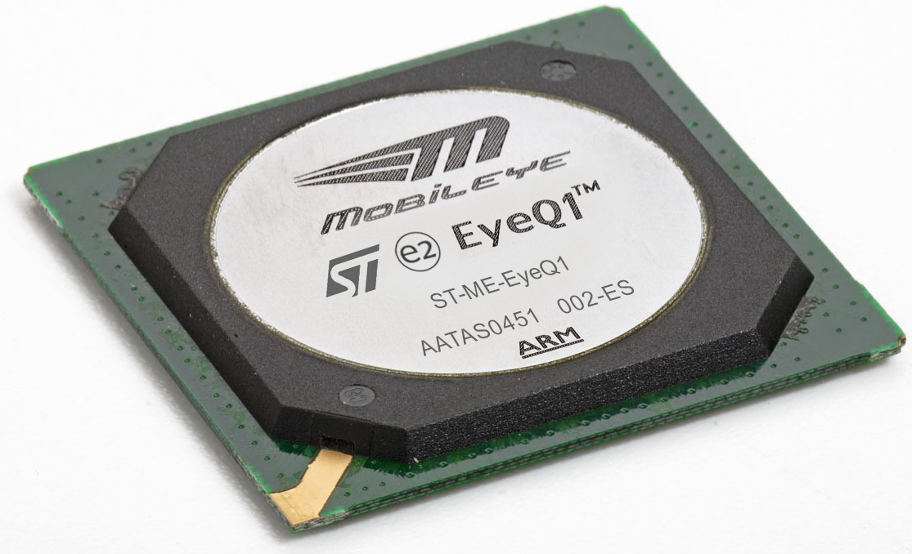
Hardware architecture
Almost all modern computers are variations of this basic model:
. . .
Intel CPU
Qualcom CPU
ARM CPU
Vic CPU

Slide 48
Hardware architecture

Slide 49
Hardware architecture
I/O devices
main memory
external
network
storage
backbone
scanner
mouse
system programs
memory stick
processing
devices
keyboard
processing
app1
hard disks
devices
app2
unused area
Cache
memory
app3
bus
processor
processor
processors
file 1 (paged)
unused area
file 2 (paged)
speakers
network
printer
file 3 (paged)
interface
card
screen
unused area

Slide 50
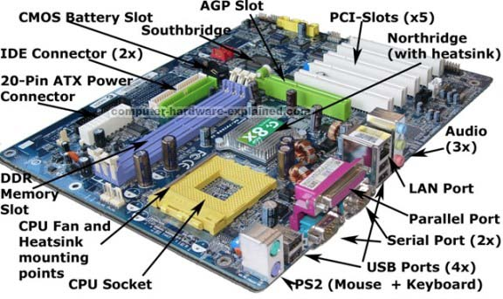
Hardware architecture
Thanks goodness for abstractions!
Computer Science (CS): Focus on logical operations
Electrical engineering (EE): Focuses on physical implementations

Slide 51
A peek into a real machine language
It’s important to remember that Vic is a simple metaphor

Slide 52
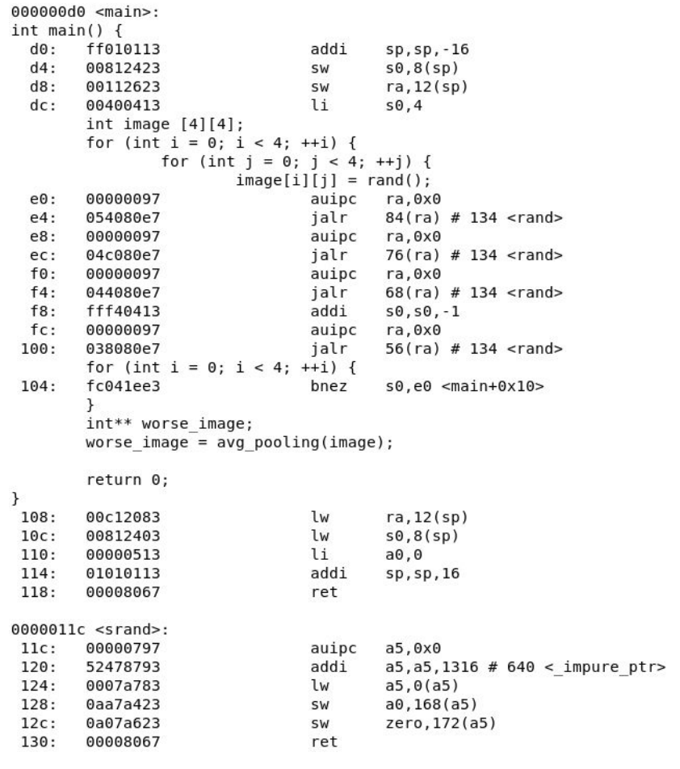
A peek into a real machine language
C program, typical 2D array processing

Slide 53
A peek into a real machine language
Tranlsated to RISCV, a 47-instruction set, used in many modern CPUs
Shows the compiled code generated by a C compiler:
1: RAM address (in hexa)
2: Binary instructions (32-bit, in hexa)
3: Symbolic instructions (op code, followed by parameters)
1
2
3

Slide 54
Introduction to Computer Science
Shimon Schocken
IDC Herzliya
Lecture 7-2
Computer Fundamentals
Part I
Notes:
54

